Slide 1

You had me at Windows Hello of Business

Slide 2

Topics
Windows Hello for Business
  What is it?
  Why is it more secure?
  Why do I need it?
  How to I get it running
  Pre-Req’s
  Unsupported Situations

Slide 3
Windows Hello for Business – What is it?
Windows Hello for Business provides a new, non-password credential for Windows 10/11 devices. It implements 2FA/MFA, meaning multilayered security that is much more difficult to bypass than protection that hinges solely on a correct username and password combination.
Hello for Business MUST have a PIN and then CAN link to biometric authentication (finger, Windows Hello Face) or Security Key (FIDO2)

Slide 4
What problem is it solving?
Strong passwords can be difficult to remember, and users often reuse passwords on multiple sites.
Server breaches can expose symmetric network credentials (passwords).
Passwords are subject to replay attacks.
Users can inadvertently expose their passwords due to phishing attack
Notes:
A replay attack occurs when an attacker copies a stream of messages between two parties and replays the stream to one or more of the parties. Unless mitigated, the computers subject to the attack process the stream as legitimate messages, resulting in a range of bad consequences, such as redundant orders of an item.

Slide 5

Why is it more secure?
How on earth can a 4-6 digit PIN be more secure than a 12 character password?
  The PIN is tied to a device
  The PIN is local to the device – it isn’t transmitted anywhere an it isn’t store anywhere else
  It is store in the TPM chip
  It can be complex – letters and number (GPO/Policy defined) – note: Be sensible, this isn’t a password!
What if the device is taken? Surely then it is less secure
  Attacker must spoof biometrics or guess the PIN – all done before TPM anti-hammering kicks in
Notes:
Imagine that someone is looking over your shoulder as you get money from an ATM and sees the PIN that you enter. Having that PIN won't help them access your account because they don't have your ATM card. In the same way, learning your PIN for your device doesn't allow that attacker to access your account because the PIN is local to your specific device and doesn't enable any type of authentication from any other device.

Slide 6
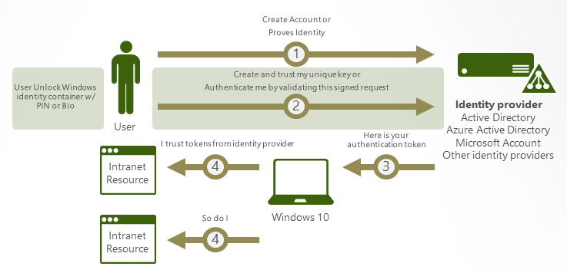
How does it work

Slide 7

How it works
Windows Hello credentials are based on certificate or asymmetrical key pair. Windows Hello credentials can be bound to the device, and the token that is obtained using the credential is also bound to the device.
An identity provider validates the user identity and maps the Windows Hello public key to a user account during the registration step. Example providers are Active Directory, Azure AD, or a Microsoft account.
Keys can be generated in hardware (TPM 1.2 or 2.0 for enterprises, and TPM 2.0 for consumers) or software, based on the policy. To guarantee that keys are generated in hardware, you must set policy.

Slide 8
How it works
Authentication is the two-factor authentication with the combination of a key or certificate tied to a device and something that the person knows (a PIN) or something that the person is (biometrics). The Windows Hello gesture doesn't roam between devices and isn't shared with the server. Biometrics templates are stored locally on a device. The PIN is never stored or shared.
The private key never leaves a device when using TPM. The authenticating server has a public key that is mapped to the user account during the registration process.

Slide 9
How it works
PIN entry and biometric gesture both trigger Windows 10 and later to use the private key to cryptographically sign data that is sent to the identity provider. The identity provider verifies the user's identity and authenticates the user.
Personal (Microsoft account) and corporate (Active Directory or Azure AD) accounts use a single container for keys. All keys are separated by identity providers' domains to help ensure user privacy.
Certificate private keys can be protected by the Windows Hello container and the Windows Hello gesture.

Slide 10

Why do I need it? Aren’t strong passwords enough?
You might be ok with long passwords but how does your user base feel about it?
Admins must configure the appropriate password settings and perform frequent resets. Gartner has estimated that between 20% and 50% of all help desk calls are for password resets.

Slide 11
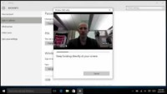
Demo – End user configuration

Slide 12
How do I get it running
New mode release at Ignite 2022 – Cloud Kerberos Trust – is the recommended deployment method unless you need cert based authentication
Windows Hello for Business cloud Kerberos trust uses Azure Active Directory (AD) Kerberos to address pain points of the key trust deployment model:
  Windows Hello for Business cloud Kerberos trust provides a simpler deployment experience because it doesn't require the deployment of public key infrastructure (PKI) or changes to existing PKI
  Cloud Kerberos trust doesn't require syncing of public keys between Azure AD and on-premises domain controllers (DCs) for users to access on-premises resources and applications. This change means there isn't a delay between the user provisioning and being able to authenticate
  Deploying Windows Hello for Business cloud Kerberos trust enables you to also deploy passwordless security keys with minimal extra setup

Slide 13
Pre-Requisites
Requirement | Notes
Multi-factor Authentication | This requirement can be met using Azure AD multi-factor authentication, multi-factor authentication provided through AD FS, or a comparable solution.
Patched Windows 10, version 21H2 or patched Windows 11 and later | If you're using Windows 10 21H2, KB5010415 must be installed. If you're using Windows 11 21H2, KB5010414 must be installed. There's no Windows version support difference between Azure AD joined and Hybrid Azure AD-joined devices.
Fully patched Windows Server 2016 or later Domain Controllers | Domain controllers should be fully patched to support updates needed for Azure AD Kerberos. If you're using Windows Server 2016, KB3534307 must be installed. If you're using Server 2019, KB4534321 must be installed.
Azure AD Kerberos PowerShell module | This module is used for enabling and managing Azure AD Kerberos. It's available through the PowerShell Gallery.
Device management | Windows Hello for Business cloud Kerberos trust can be managed with group policy or through mobile device management (MDM) policy. This feature is disabled by default and must be enabled using policy.

Slide 14
Unsupported Situations
The following scenarios aren't supported using Windows Hello for Business cloud Kerberos trust:
  On-premises only deployments – AAD Connect required along with AAD
  RDP/VDI scenarios using supplied credentials (RDP/VDI can be used with Remote Credential Guard or if a certificate is enrolled into the Windows Hello for Business container)
  Scenarios that require a certificate for authentication
  Using cloud Kerberos trust for "Run as"
  Signing in with cloud Kerberos trust on a Hybrid Azure AD joined device without previously signing in with DC connectivity

Slide 15
Deployment
If you've already deployed on-premises SSO for passwordless security key sign-in, then you've already deployed Azure AD Kerberos in your hybrid environment. You don't need to redeploy or change your existing Azure AD Kerberos deployment to support Windows Hello for Business and you can skip this section.
If you haven't deployed Azure AD Kerberos you need to create an Azure AD Kerberos Server object for the domains where you want to use Windows Hello for Business cloud Kerberos trust. (PSH only here)

Slide 16

Policies - Intune
Device Enrolment or Device Configuration Policy – Config policy recommended
  The cloud Kerberos trust policy needs to be configured using a custom template and is configured separately from enabling Windows Hello from Business.
Enable Windows Hello for Business
  If you already enabled Windows Hello for Business for a target set of users or devices, you can skip below to configuring the cloud Kerberos trust policy. Otherwise, follow the instructions at Integrate Windows Hello for Business with Microsoft Intune to create a Windows Hello for Business device enrollment policy.

Slide 17
Intune Process
Sign in to the Microsoft Endpoint Manager admin center.
1
Browse to Devices > Windows > Configuration Profiles > Create profile.
2
For Platform, select Windows 10 and later.
3
For Profile Type, select Templates and select the Custom Template.
4
Name the profile with a familiar name. For example, "Windows Hello for Business cloud Kerberos trust".
5

Slide 18
Intune Process
In Configuration Settings, add a new configuration with the following settings (below)
Select Next to navigate to Assignments.
Under Included groups, select Add groups.
Setting
Name: Windows Hello for Business cloud Kerberos trust or another familiar name Description (optional): Enable Windows Hello for Business cloud Kerberos trust for sign-in and on-premises SSO OMA-URI: ./Device/Vendor/MSFT/PassportForWork/<tenant ID>/Policies/UseCloudTrustForOnPremAuth Data type: Boolean Value: True

Slide 19

Intune Process
Select the user group you would like to use Windows Hello for Business cloud Kerberos trust. This group may be WHFB cloud Kerberos trust users or a group of your choosing.
Select Next to move to the Applicability Rules.
Select Next again to move to the Review + create tab and select the option to create the policy.

Slide 20
Policies - GPO
The Enable Windows Hello for Business Group Policy setting is used by Windows to determine if a user should attempt to enroll a credential. A user will only attempt enrollment if this policy is configured to enabled.
Update your GPO’s from Win 10 21H2/Win 11 and if you haven’t already, move to a central store

Slide 21
GPO Step by Step
Start the Group Policy Management Console (gpmc.msc).
Expand the domain and select the Group Policy Object node in the navigation pane.
Right-click Group Policy object and select New.
Type Enable Windows Hello for Business in the name box and click OK.
In the content pane, right-click the Enable Windows Hello for Business Group Policy object and click Edit.
In the navigation pane, expand Policies under Device Configuration.
Expand Administrative Templates > Windows Component, and select Windows Hello for Business.
In the content pane, double-click Use Windows Hello for Business. Click Enable and click OK.
In the content pane, double-click Use cloud Kerberos trust for on-premises authentication. Click Enable and click OK.
Optional but recommended: In the content pane, double-click Use a hardware security device. Click Enable and click OK.

Slide 22

Provisioning
The Windows Hello for Business provisioning process begins immediately after a user has signed in if certain prerequisite checks are passed. Windows Hello for Business cloud Kerberos trust adds a prerequisite check for Hybrid Azure AD-joined devices when cloud Kerberos trust is enabled by policy.
You can determine the status of the prerequisite check by viewing the User Device Registration admin log under Applications and Services Logs\Microsoft\Windows. This information is also available using the dsregcmd /status command from a console.
Notes:
The cloud Kerberos trust prerequisite check detects whether the user has a partial TGT before allowing provisioning to start. The purpose of this check is to validate whether Azure AD Kerberos is set up for the user's domain and tenant. If Azure AD Kerberos is set up, the user will receive a partial TGT during sign-in with one of their other unlock methods. This check has three states: Yes, No, and Not Tested. The Not Tested state is reported if cloud Kerberos trust is not being enforced by policy or if the device is Azure AD joined.
This prerequisite check isn't done for provisioning on Azure AD-joined devices. If Azure AD Kerberos isn't provisioned, a user on an Azure AD joined device will still be able to sign in.

Slide 23
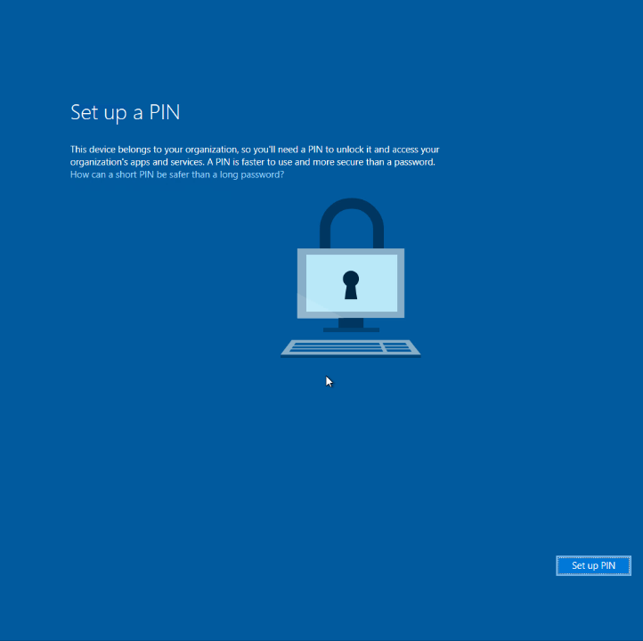
PIN Setup
When Windows Hello for Business provisioning begins, the user will see a full screen page with the title Setup a PIN and button with the same name. The user clicks Setup a PIN.
The provisioning flow proceeds to the multi-factor authentication portion of the enrollment. Provisioning informs the user that it's actively attempting to contact the user through their configured form of MFA. The provisioning process doesn't proceed until authentication succeeds, fails or times out
After a successful MFA, the provisioning flow asks the user to create and validate a PIN. This PIN must observe any PIN complexity requirements that you deployed to the environment.

Slide 24
Sign in
Once a user has set up a PIN with cloud Kerberos trust, it can be used immediately for sign-in. On a Hybrid Azure AD joined device, the first use of the PIN requires communication to a DC. Once the user has signed in or unlocked with the DC, cached logon can be used for subsequent unlocks without line of sight or network connectivity.

Slide 25
Resources
Hybrid Cloud Kerberos Trust Deployment - https://learn.microsoft.com/en-us/windows/security/identity-protection/hello-for-business/hello-hybrid-cloud-kerberos-trust?tabs=intune
Windows Hello for Business Frequently Asked Questions (FAQ) https://learn.microsoft.com/en-us/windows/security/identity-protection/hello-for-business/hello-faq
Enable passwordless security key sign-in to on-premises resources by using Azure AD - https://learn.microsoft.com/en-us/azure/active-directory/authentication/howto-authentication-passwordless-security-key-on-premises#create-a-kerberos-server-object
90 second Windows Hello demo - https://www.youtube.com/watch?v=CrWccE6P0ws

